Slide 1
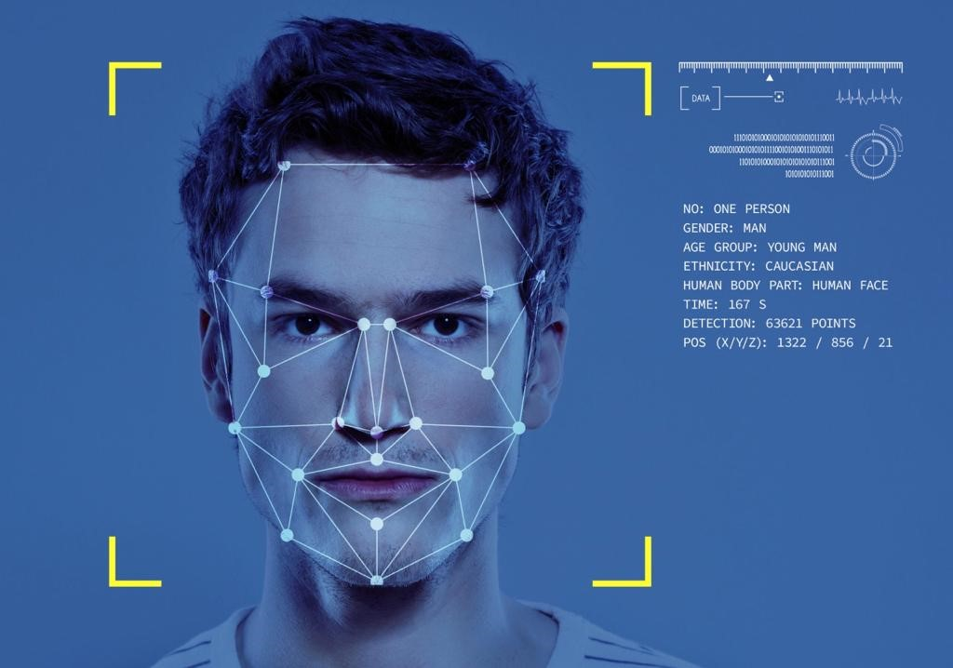
CELEBVISION:
Comprehensive Celebrity Image Processing
2024SP_MLDS_432-1_SEC20 Deep Learning Final Project
Siyan Li, Stella Wang, Xinran Wang, Yumin Zhang

Slide 2
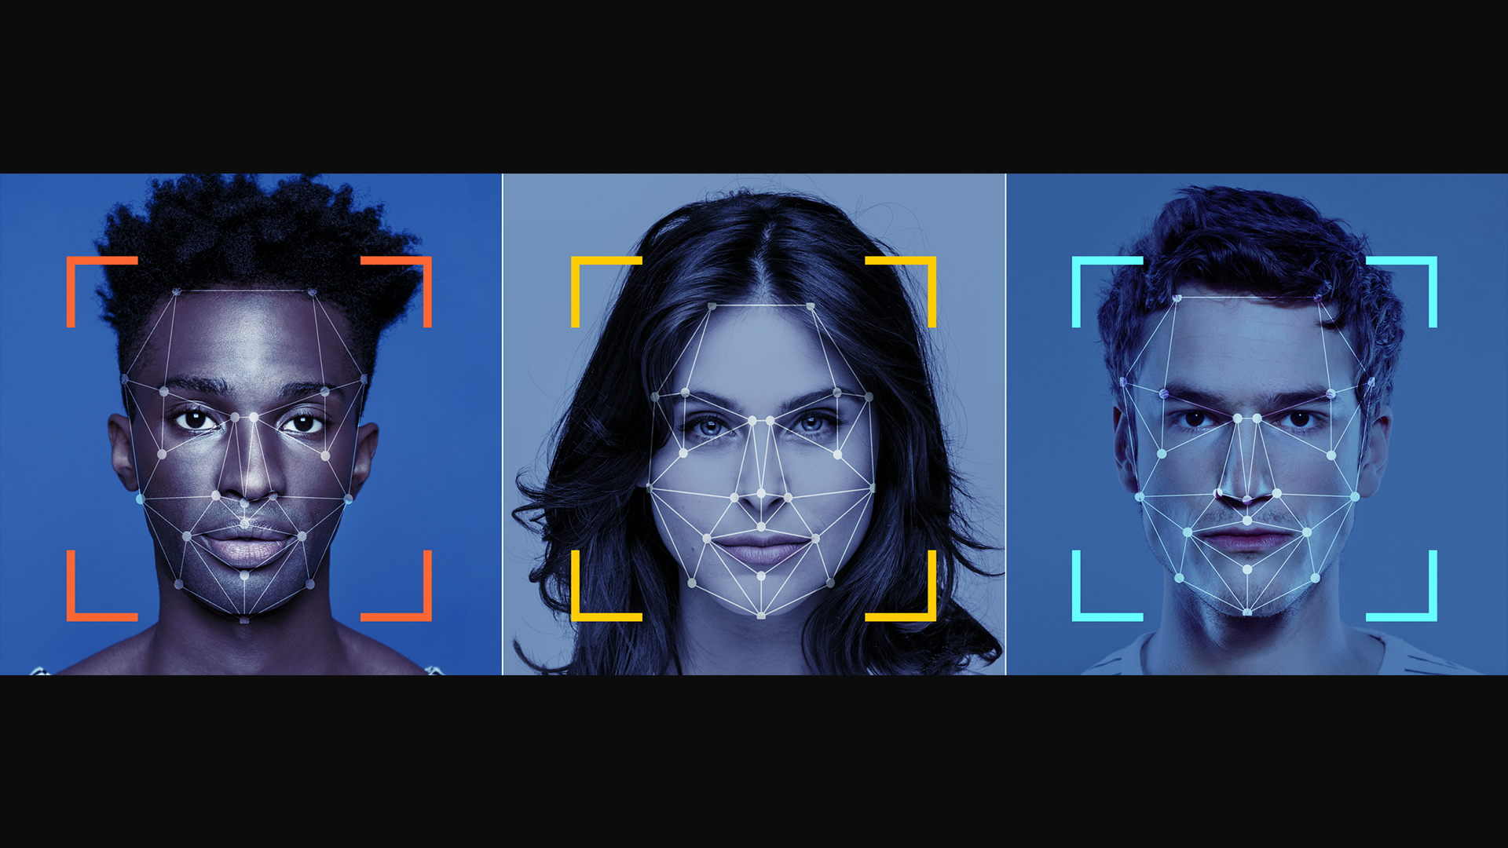
Table of Contents
Data Overview
Task 1: Image Classification
Customized: CNN
Pretrained: InceptionV3
Task 2: Style Transfer
Customized: CycleGAN
Pretrained: VGG-19
Application: Streamlit
Model Operations & Parameter Update
Conclusion
References
Notes:
Abstract: Written collaboratively, briefly summarize the problem, your approach, and describe results.

Slide 3
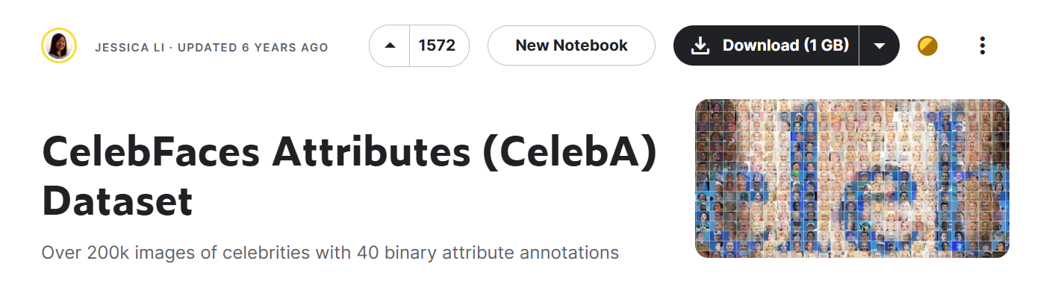
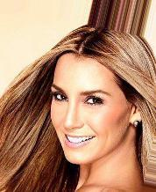
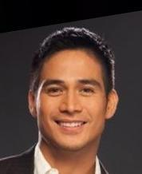
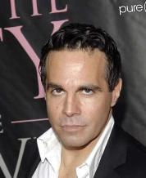
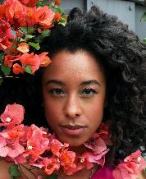
DATA OVERVIEW
Tabular Data:
Total Rows:
202,599
Total Columns:
40 (Attributes)
No Missing Values
Data Characteristics:
Type: Dataset Type: Image dataset with corresponding attributes.
Images: 202,599 images of celebrities, each annotated with various facial attributes.
Notes:
• Summarize data: record counts, missing values, and schema
• Visualize the raw dataset using charts and tables (line/bar charts, q-q plots, heatmaps, violin, etc.)
• Structured Data: Perform univariate and bivariate analysis of the features
• Image Data: Histograms, samples, outliers

Slide 4
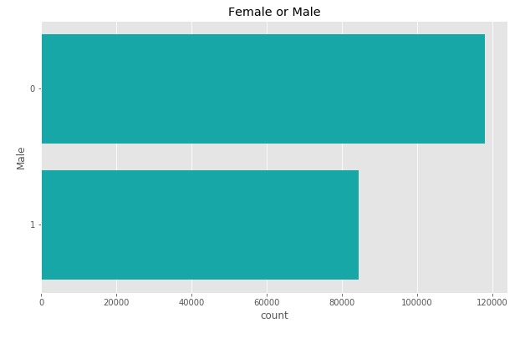
Visualization
Notes:
• Summarize data: record counts, missing values, and schema
• Visualize the raw dataset using charts and tables (line/bar charts, q-q plots, heatmaps, violin, etc.)
• Structured Data: Perform univariate and bivariate analysis of the features
• Image Data: Histograms, samples, outliers

Slide 5
TASK 01.
Image classification
Classify the gender of the faces

Slide 6
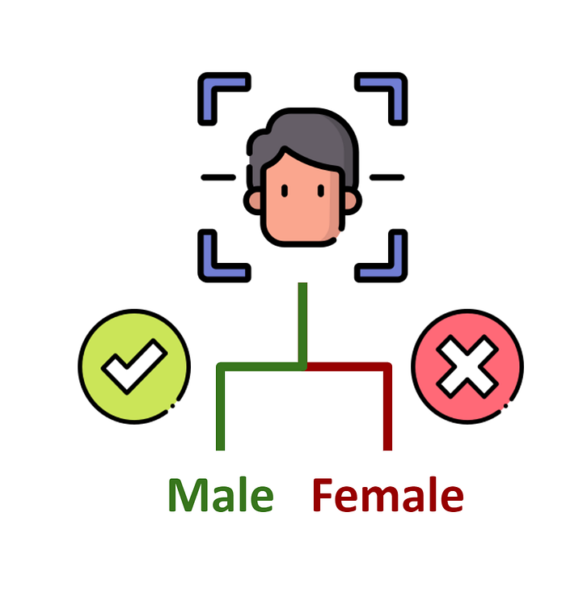
Objective
GOAL
To develop and evaluate deep learning models capable of accurately classifying the gender of individuals in the CelebA dataset based on facial attributes.
models
Customized CNN & InceptionV3

Slide 7
Customized model: cnn
PROS
CONS
ARchitecture
Tailored Architecture:
Custom design for better performance.
Control Over the Model:
Optimize the architecture and adapt to specific data characteristics
Resource and Expertise Demands:
Time-consuming and computationally intensive
Risk of Overfitting:
Higher risk of overfitting for small or unbalanced datasets
Customized CNN is a deep convolutional neural network (CNN) designed specifically for the CelebFaces data to optimize performance.
Notes:
First model for the gender classification
Pros:
Customization allows for a model specifically designed to suit the dataset, potentially leading to better performance.
Full control over the architecture enables detailed optimization and adaptation to specific dataset characteristics.
Cons:
Designing, tuning, and training a custom CNN from scratch is time-consuming and computationally intensive
Custom models can overfit to the training data, especially with small or unbalanced datasets.

Slide 8
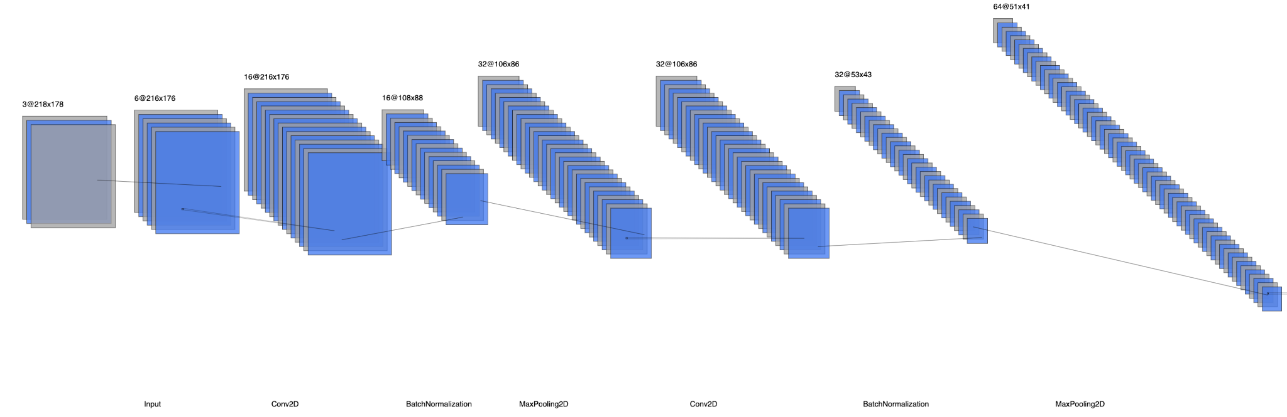
Customized model: cnn
Model Architecture (first few layers)
Notes:
Input Layer: Accepts 218x178 pixel images with 3 color channels (RGB).
We have four Conv2D layers with increasing filters (16, 32, 64, 64) and 3x3 kernels to extract features
Batch Normalization and Max Pooling are applied after each Conv2D layer to stabilize training and reduce spatial dimensions.
Then we have Dropout Layers, which are placed after pooling layers to prevent overfitting
Flatten Layer: Converts 3D feature maps into a 1D vector.
Dense Layers: Two dense layers with 64 and 32 units, including batch normalization and dropout for regularization.
Output Layer: A final dense layer with 2 units and softmax activation for classifying images into two categories.

Slide 9
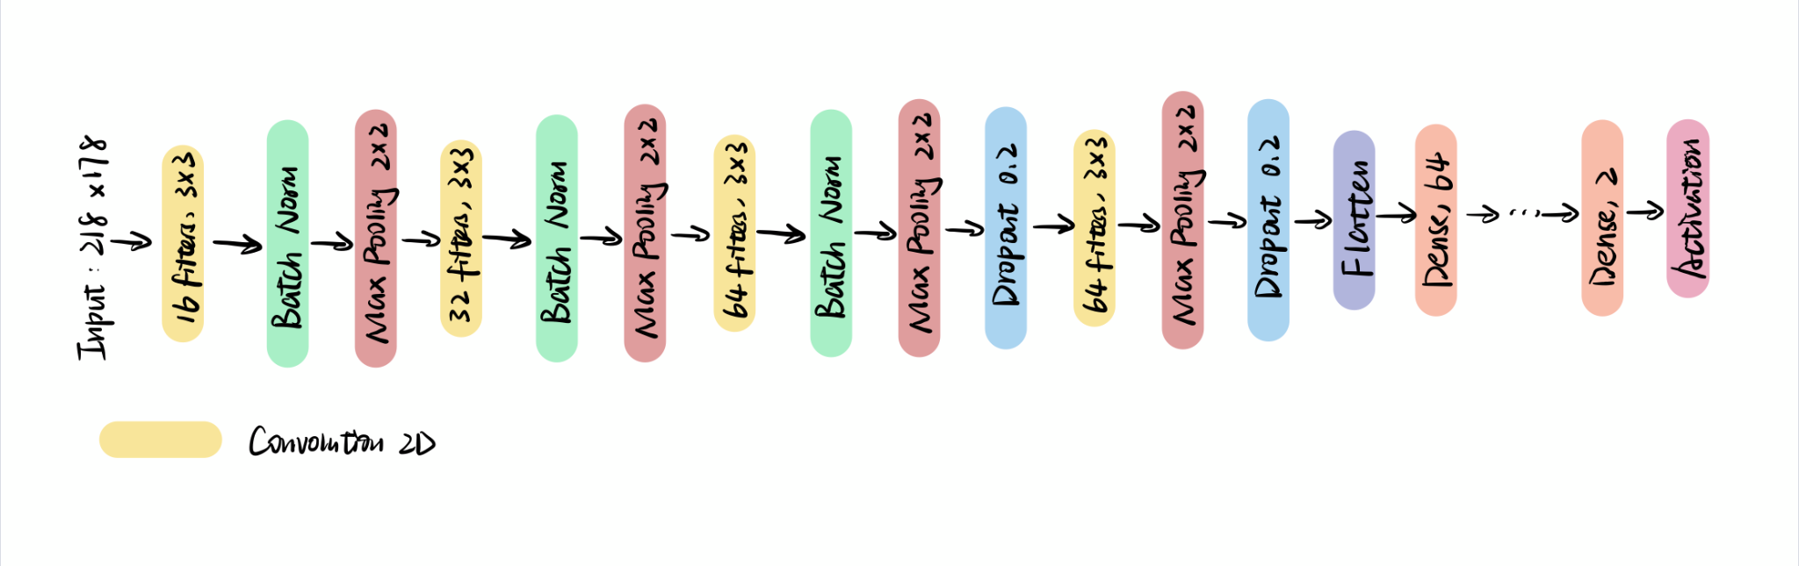
Customized model: cnn
Model Architecture (Continued)
full model architecture.

Slide 10
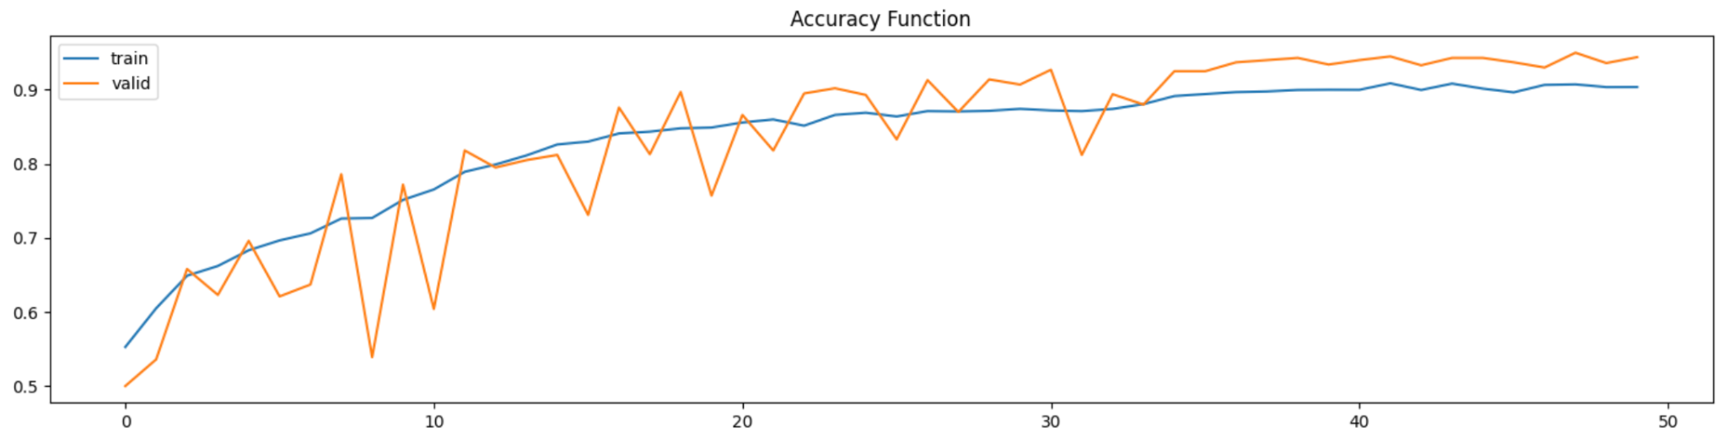
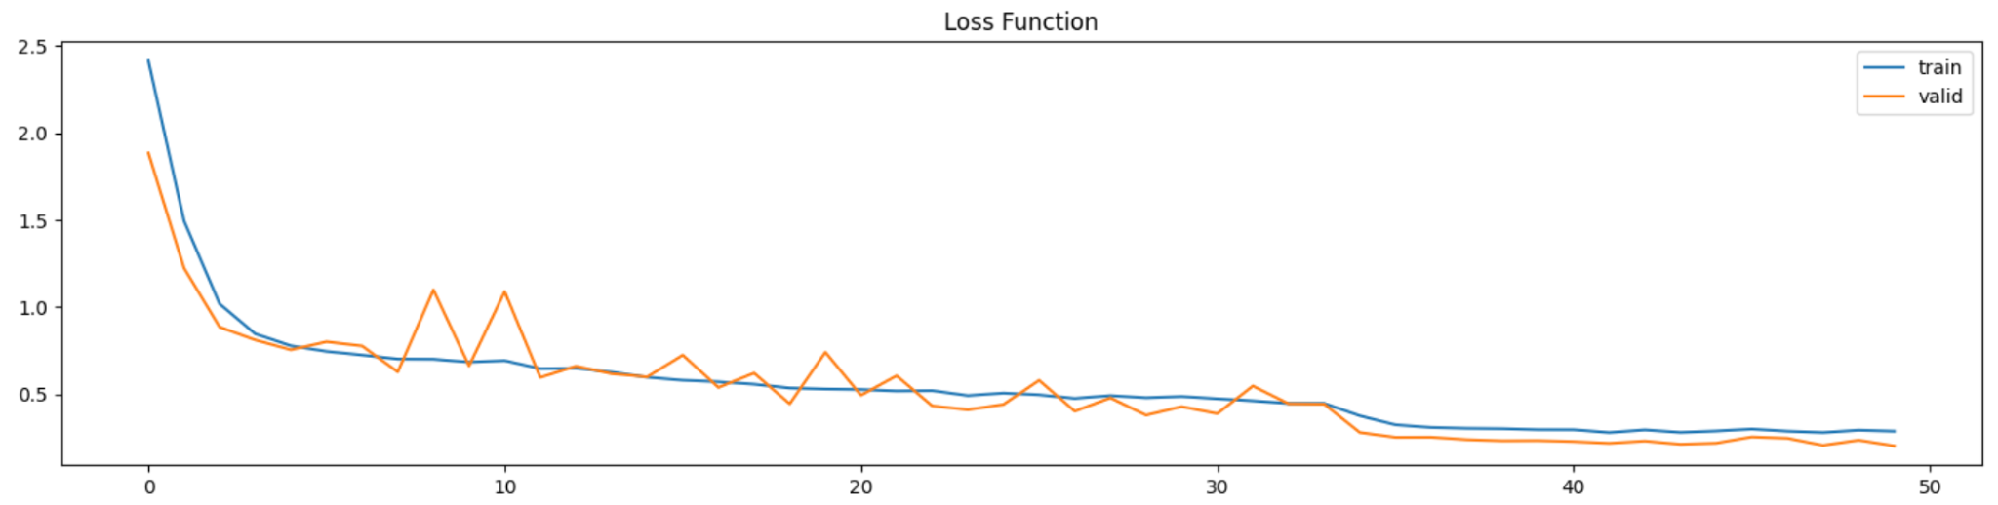
Customized model: cnn
Notes:
the model shows good learning behavior with increasing accuracy and decreasing loss for both training and validation datasets,

Slide 11
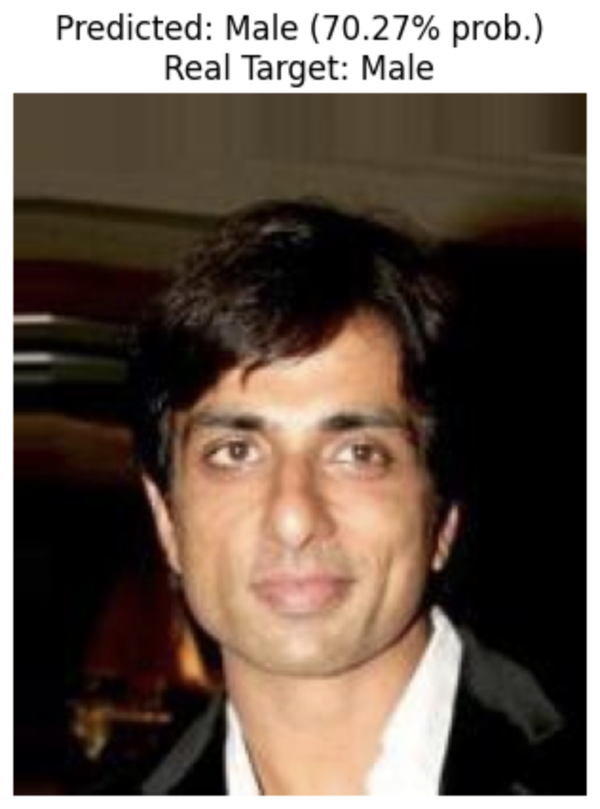
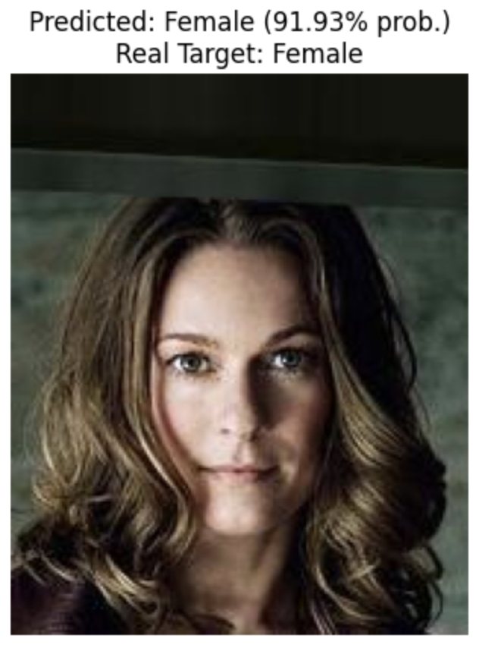
Customized model: cnn
Demo:

Slide 12
pretrained model: InceptionV3
PROS
CONS
ARchitecture
High Accuracy: InceptionV3 has demonstrated excellent performance on a variety of image classification tasks, making it well-suited for gender classification on the CelebA dataset.
Scalability: InceptionV3 can handle large-scale datasets like CelebA with many images and attributes, making it versatile for extensive facial attribute analysis.
Complexity: The architecture is complex, with multiple types of convolutions and pooling operations within each module, making it harder to implement and tune compared to simpler models.
InceptionV3 is a deep convolutional neural network (CNN) designed by Google.

Slide 13
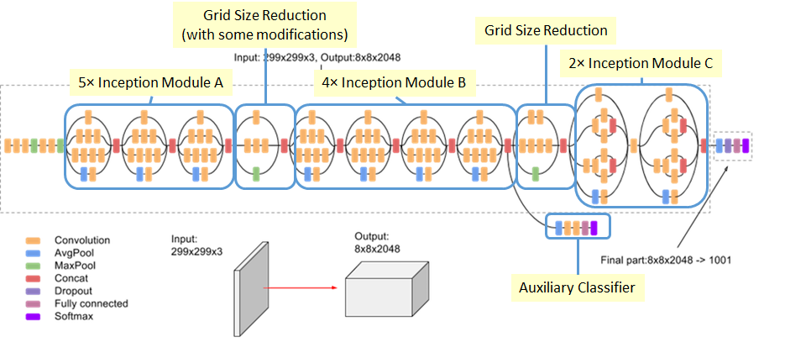
Figure from: Szegedy, Christian, Vincent Vanhoucke, Sergey Ioffe, Jon Shlens, and Zbigniew Wojna, 2016

Slide 14
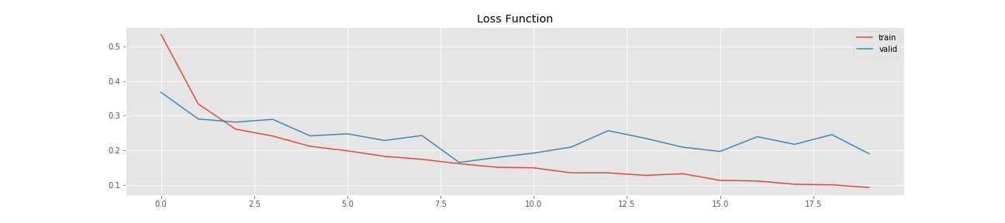
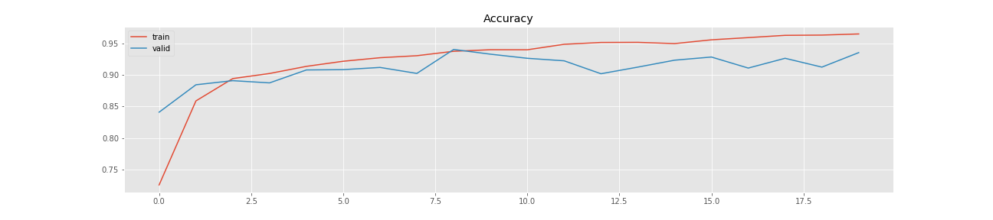
pretrained model: InceptionV3

Slide 15
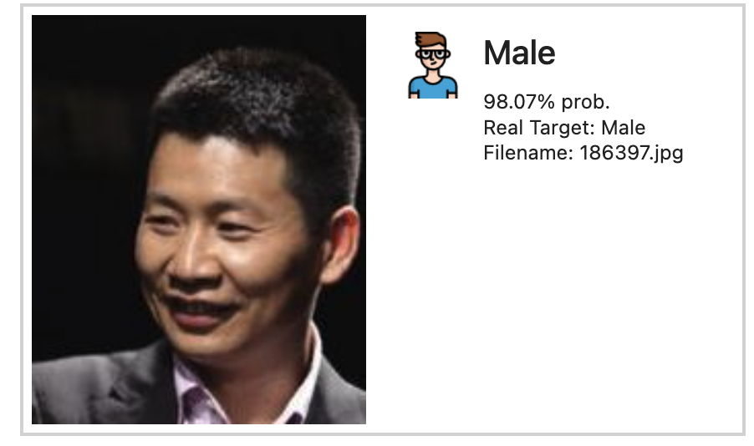
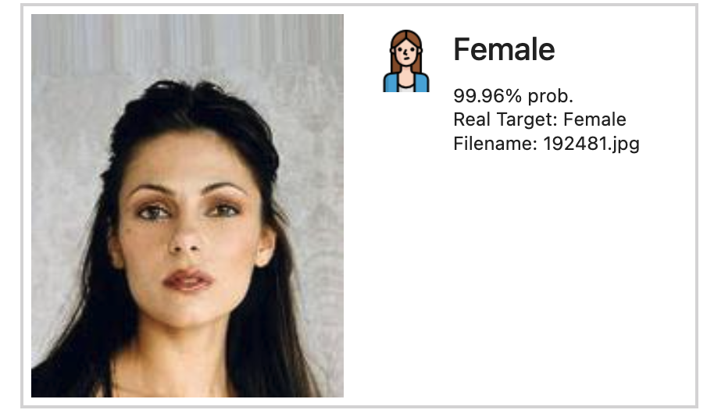
pretrained model: InceptionV3
Demo:

Slide 16
Model evaluation:
customIZED CNN vs InceptionV3
 | accuracy | F1 score | precision | recall | ROC-AUC
CustomizeD CNN | 94.4% | 0.944 | 0.945 | 0,944 | 0,980
InceptionV3 | 93.2% | 0.931 | 0.934 | 0.932 | 0.987
Notes:
In this project, we evaluated the performance of two convolutional neural network architectures: a customized CNN and the well-known InceptionV3 model. The evaluation metrics include Accuracy, F1 Score, Precision, Recall, and ROC-AUC.
While both models show similar performance, the customized CNN slightly outperforms InceptionV3 in most metrics. However, it's important to note that InceptionV3 takes significantly less time to train.

Slide 17
Task 02.
STYLE TRANSFER
Transfer the style of the given face image

Slide 18
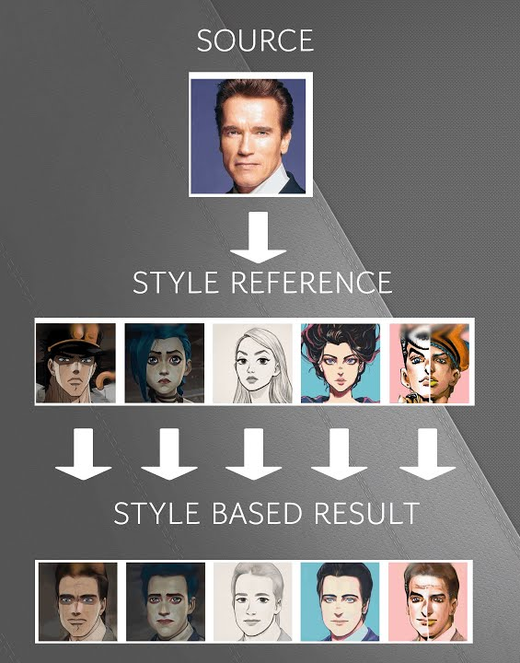
Objective
GOAL
Train and evaluate a model to apply a specific artistic style to the content of a image.
models
CycleGAN & VGG19

Slide 19


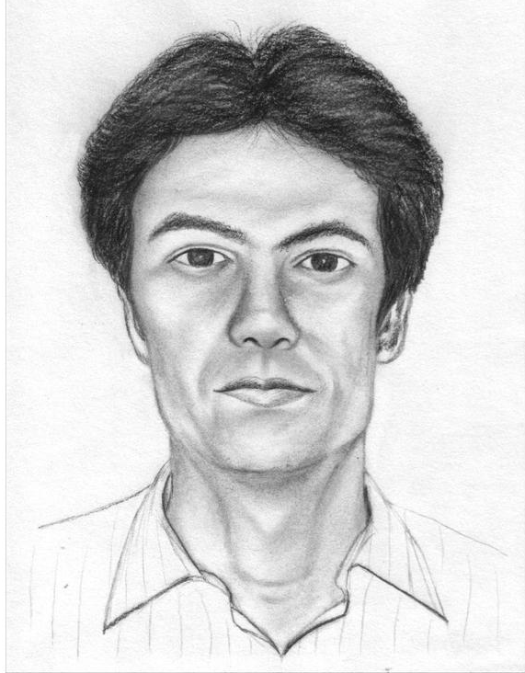
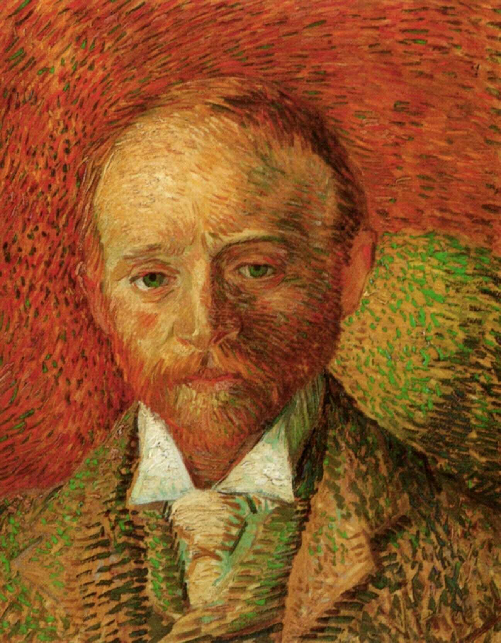
ADDITIONAL DATASETS
Sketch
vangogh
CARTOON
CUHK Face Sketch Database Sketch Drawn Based on photos
Van Gogh Paintings
Art-Work Sample of Vincent
cartoonset10k
Cartoon Images by Google

Slide 20
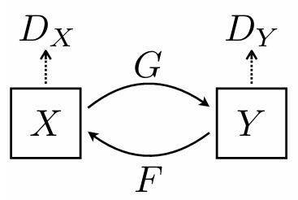
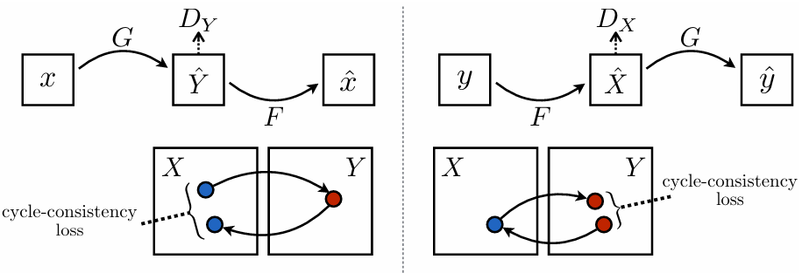
Customized model: cyclegan
Generator loss
ARchitecture
GAN vs CycleGAN
Adversarial loss (L2/MSE).
Identity loss (L1/MAE).
Forward cycle loss (L1/MAE).
Backward cycle loss (L1/MAE).
L2/MSE: for label
L1/MAE: for image
Figure from: Zhu, Jun-Yan, 2017.

Slide 21
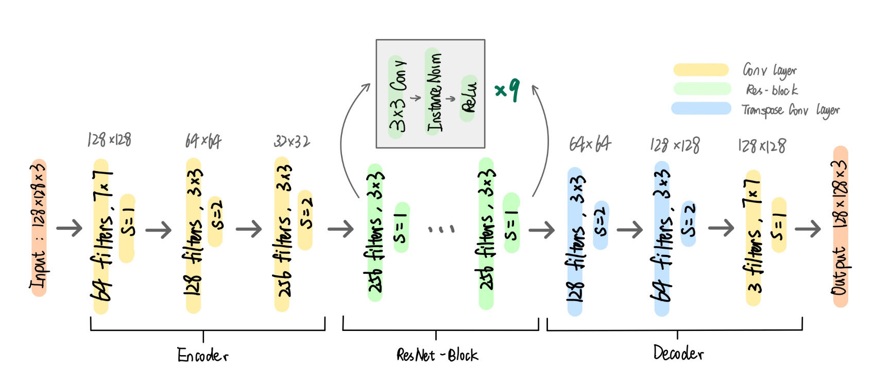
Customized model: cyclegan
Generator

Slide 22
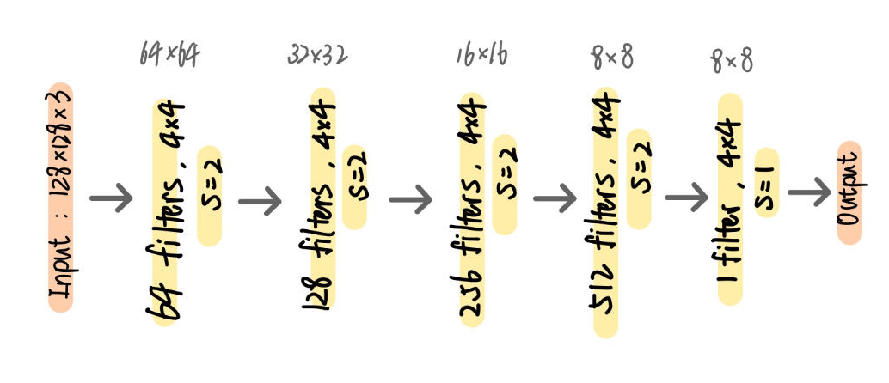
Customized model: cyclegan
Discriminator
Notes
batchsize = 1
Instance normalization instead of batch normalization

Slide 23
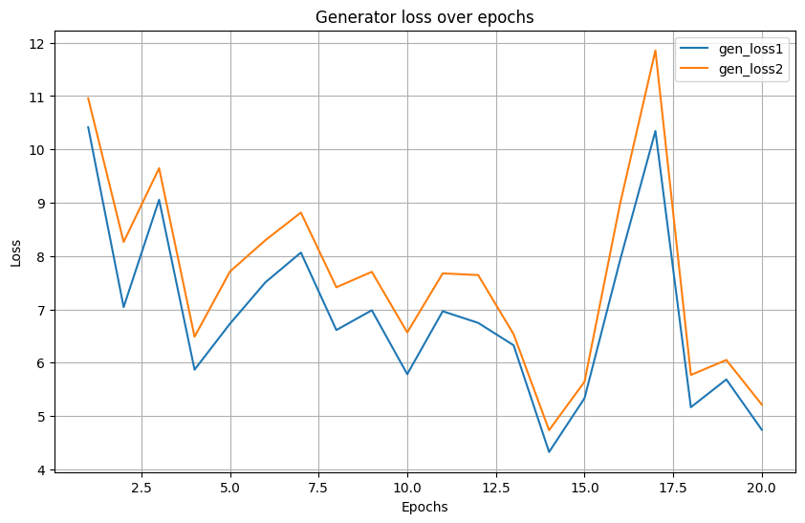
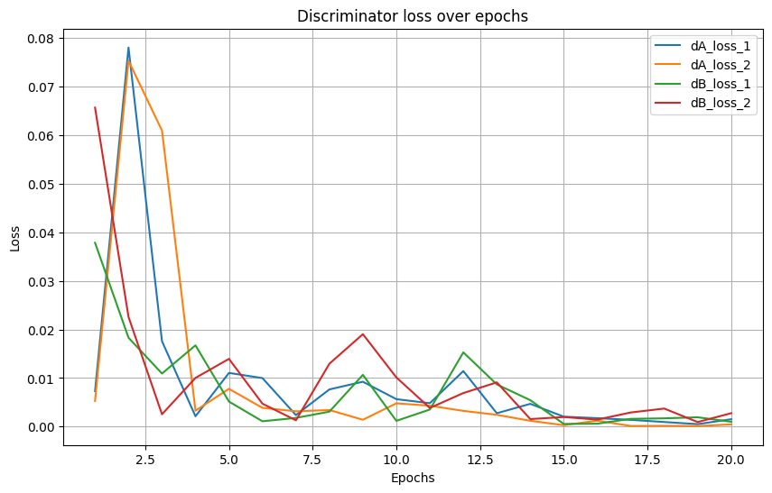
Customized model: cyclegan
Loss1: real
Loss2: fake
Weighted average of:
Adversarial loss (L2/MSE).
Identity loss (L1/MAE).
Forward cycle loss (L1/MAE).
Backward cycle loss (L1/MAE).
NOT accurately reflect quality

Slide 24
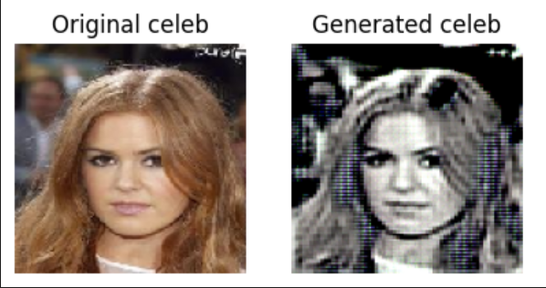
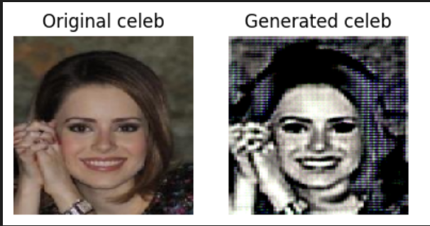
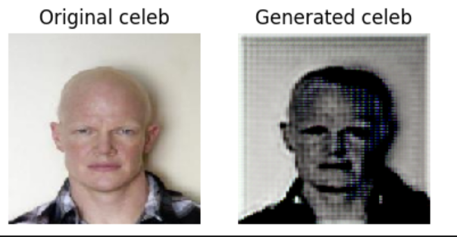
Customized model: cyclegan
Sketch style

Slide 25
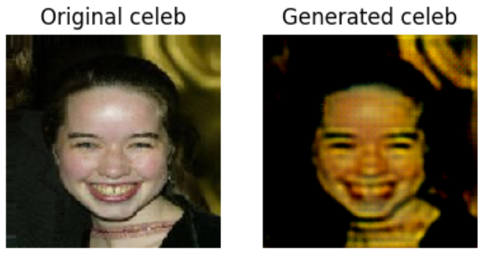
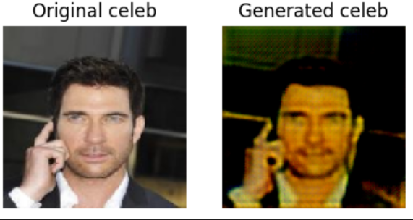
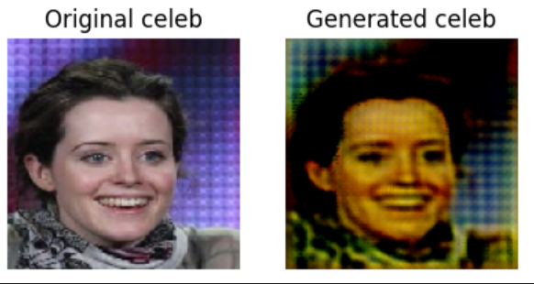
Customized model: cyclegan
VAN GOGH style

Slide 26
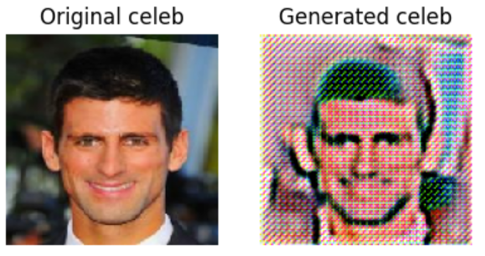
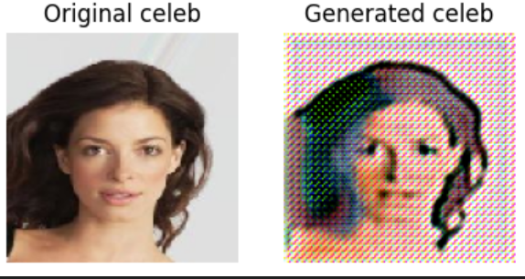
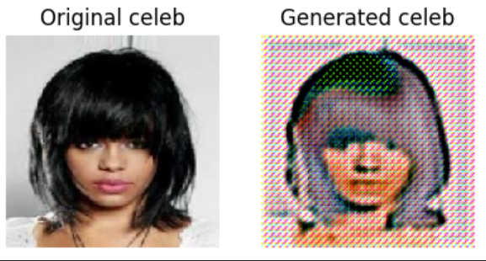
Customized model: cyclegan
CARTOON style

Slide 27
Application example:
By Streamlit

Slide 28
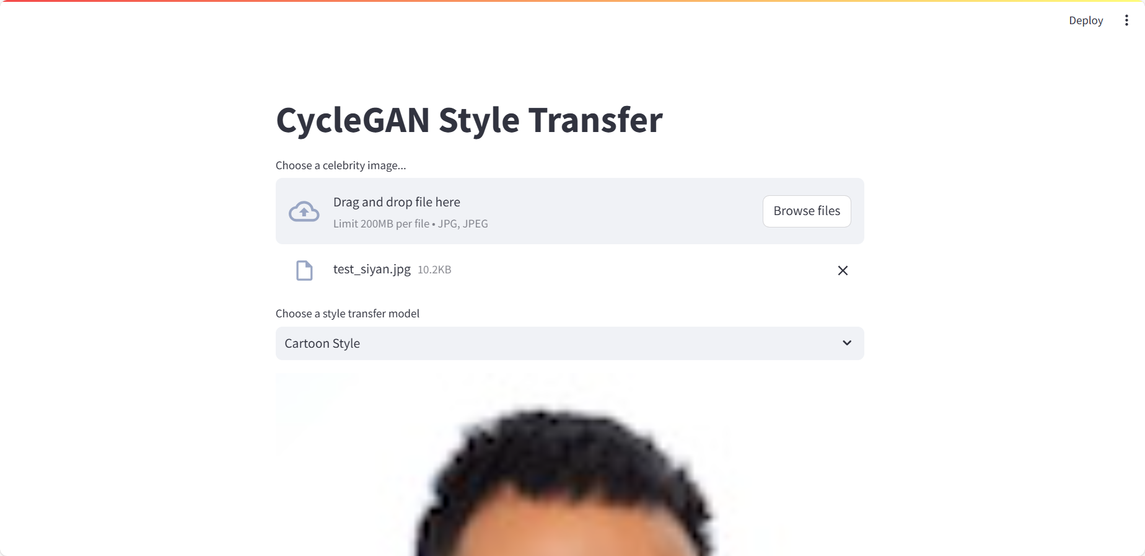
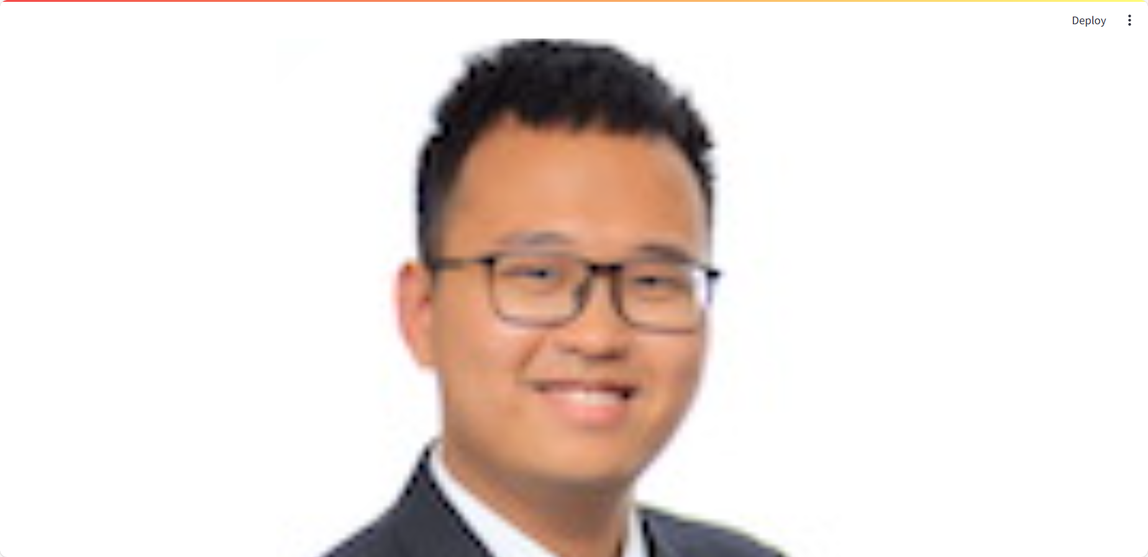
Application example:
By Streamlit

Slide 29
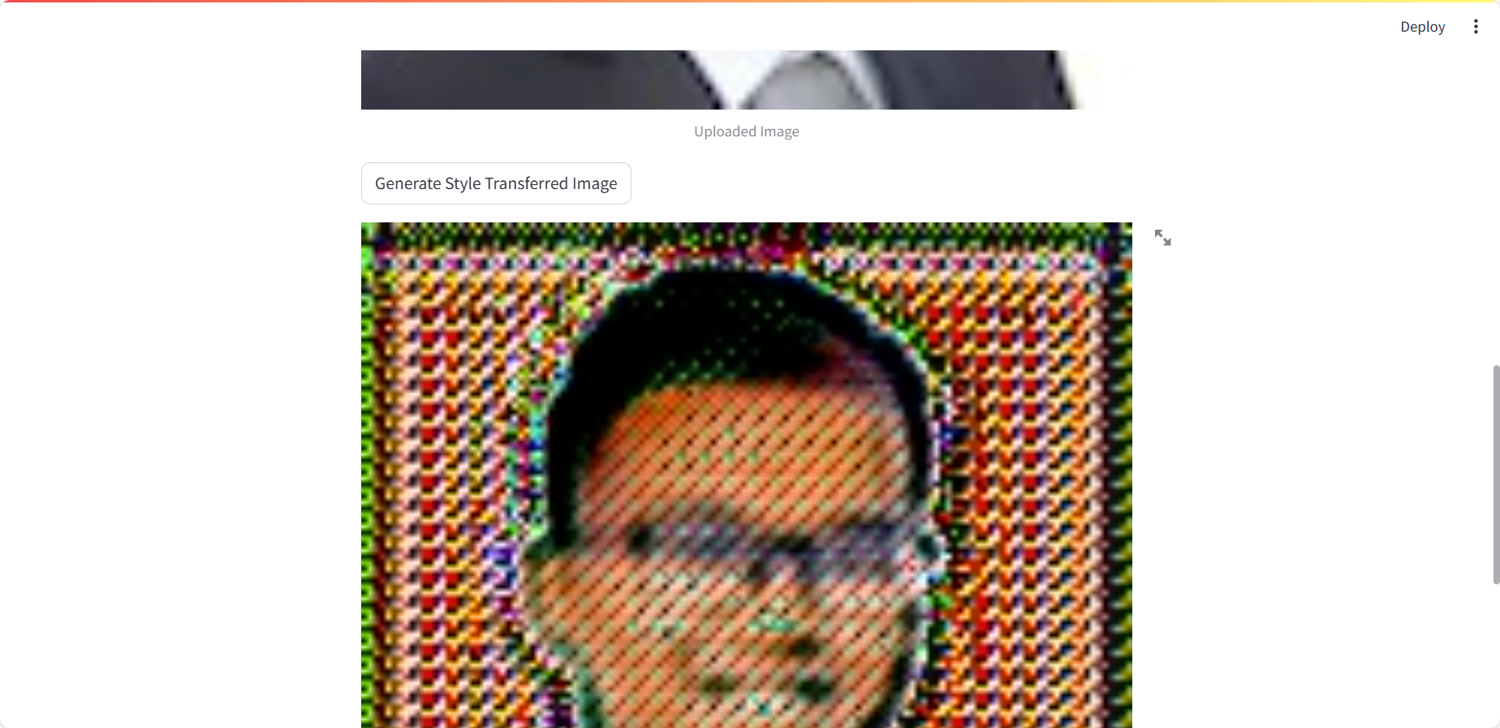
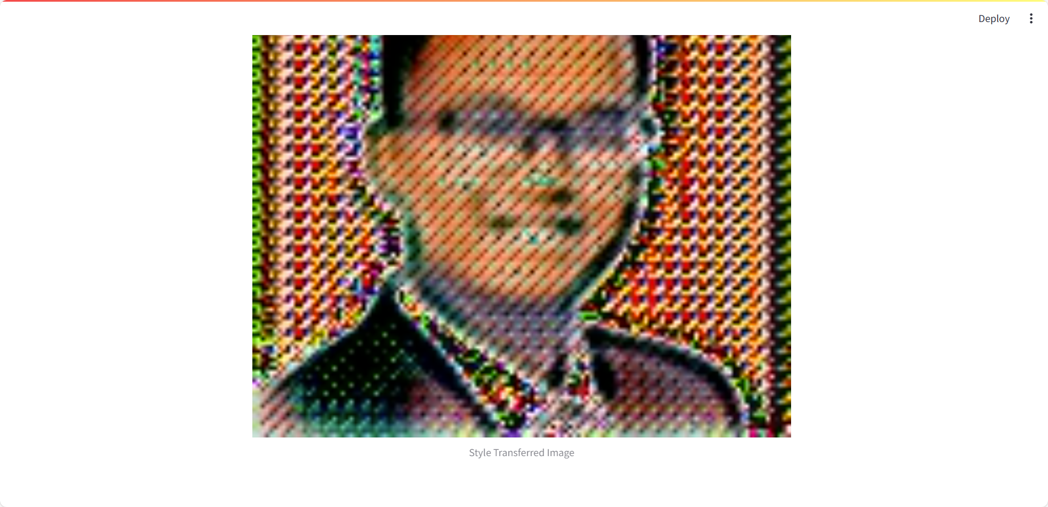
Application example:
By Streamlit

Slide 30
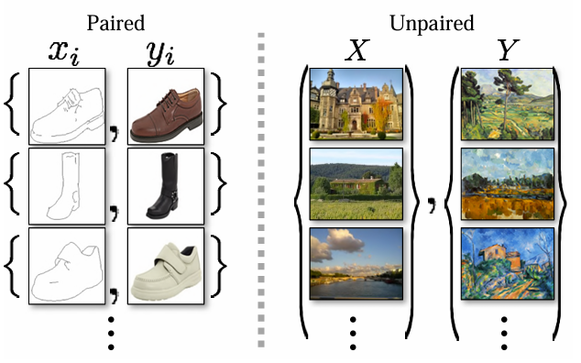
Customized model: cyclegan
PROS
CONS
Unpaired data, unlike Pix2Pix
Tuning Difficulty
The performance can be highly sensitive to hyperparameters such as weights of loss components.
Blurriness
The generated images may sometimes contain artifacts or appear blurry.
Figure from: Zhu, Jun-Yan, 2017.

Slide 31
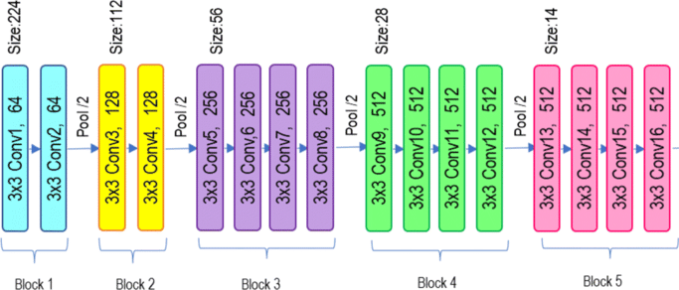
pretrained model: vgg-19
ARchitecture
Overview
19 layers CNN
Pretrained model on ImageNet classification
Employ it for feature extraction

Slide 32
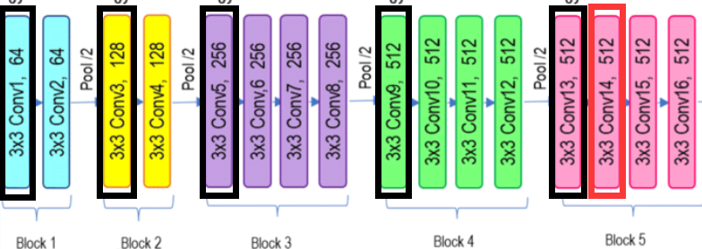
Pretrained model: vgg-19
Extracted layers
Black Rectangle:
Style extraction
Red Rectangle:
Content extraction
Notes:
reference

Slide 33
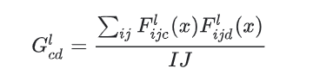
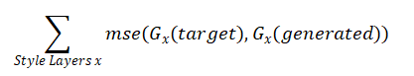
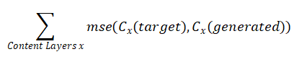
Pretrained model: vgg-19
Style formula
Loss Function=Style loss + content loss
For each style layer extracted, we can calculate style matrix by the means and correlations across the different feature map channels

Slide 34
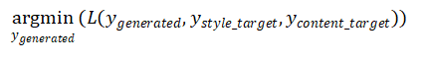
Pretrained model: vgg-19
Training? Generation!
Loss function : L(target content, target style, generated image)
We have a loss function, so we can do gradient descent, but on which parameters?
The trainable parameters are exactly the generated image
The gradient descent “training” process is actually the “generation” process

Slide 35
Pretrained model: vgg-19
PROS
CONS
Easy to implement
Computation efficiency
Only need one graph as style graph instead of large training dataset
No model saved
Need to generate for every new input style/content images
Hard to compare the loss across different generation tasks

Slide 36
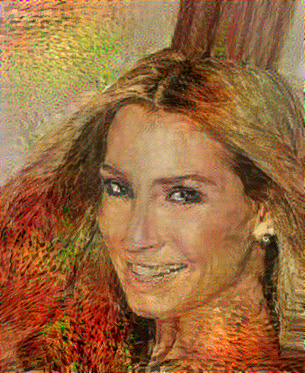


Pretrained model: vgg-19
Notes:
Add cartoon

Slide 37
Application example:
By Streamlit

Slide 38


Streamlit Deployment

Slide 39

Model Operations
OPeration Architecture

Slide 40
MODEL Maintenance and parameter update
Maintenance
Parameter UPdate
Infrastructure: AWS
Fetch new data from AWS S3 and retrain the model
Use CloudWatch to keep track of the application health
Model can read config file to customize the neural network structure and hyperparameters
Can set periodical retraining for parameter updates

Slide 41
Conclusion
Image classification task:
Both high accuracy, customized CNN slightly higher.
Our findings emphasize the importance of model selection and customization based on the task requirements and dataset properties. While pre-trained models like InceptionV3 and VGG-19 offer robust performance and ease of implementation, customized models can provide superior results with sufficient tuning and resource investment.
Style transfer task:
Depends on style:
VGG-19 models better transfer styles with texture features, such as the Van Gogh style.
For simpler styles like sketches, both the CycleGAN and VGG-19 models performed well.
However, both models struggled with the cartoon style.
Notes:
However, both models struggled with the cartoon style, indicating a need for further refinement to handle more abstract and exaggerated visual features.

Slide 42
References
[1] Zhu, Jun-Yan, Taesung Park, Phillip Isola, and Alexei A. Efros. "Unpaired image-to-image translation using cycle-consistent adversarial networks." In Proceedings of the IEEE international conference on computer vision, pp. 2223-2232. 2017.
[2] Szegedy, Christian, Vincent Vanhoucke, Sergey Ioffe, Jon Shlens, and Zbigniew Wojna. “Rethinking the Inception Architecture for Computer Vision.” 2016 IEEE Conference on Computer Vision and Pattern Recognition (CVPR), June 2016. https://doi.org/10.1109/cvpr.2016.308.
[3] VGG-19 architecture [39]. VGG-19 has 16 convolution layers grouped into... | download scientific diagram. Accessed May 31, 2024. https://www.researchgate.net/figure/VGG-19-Architecture-39-VGG-19-has-16-convolution-layers-grouped-into-5-blocks-After_fig5_359771670.
[4] “Neural Style Transfer : Tensorflow Core.” TensorFlow. Accessed May 30, 2024. https://www.tensorflow.org/tutorials/generative/style_transfer.

Slide 43
DATASET LINKS
[1] https://www.kaggle.com/datasets/jessicali9530/celeba-dataset
[2] https://www.kaggle.com/datasets/arbazkhan971/cuhk-face-sketch-database-cufs
[3] https://www.kaggle.com/datasets/ipythonx/van-gogh-paintings
[4] https://www.kaggle.com/datasets/imreallyjohn/cartoonset10k

Slide 44
APPENDIX: Data preprocessing
Data sampling
Data augmentation
Define a function to load and reshape images. Sample an equal number of male and female images for training, validation, and testing.
Use ImageDataGenerator for data augmentation. Apply transformations such as rotation, shift, shear, zoom, and flip.
Data loading
Data splitting
Combine gender and partition data into a single DataFrame.
Split data into training, validation, and test sets using the sampling function

Slide 45
Thank you !

